Slide 1





Autonomous Industrial IoT Digital Twin & Predictive Maintenance Engine with Closed-Loop ERP Action
Likith D T
Kruthin H
Under the mentorship of,
Mentor Name: Mr. Indranil Bakshi
Notes:
Slide Duration: 5 min
Objective: To get an insight about Design Thinking
Procedure:
Explanation:
Introduce the topic "Design Thinking"
Design thinking is a creative approach to problem-solving that puts people at the center.
It starts with understanding the needs of those who will use what you're designing.
Then, it involves brainstorming ideas, prototyping solutions, and testing them to see what works best.
It's about being open-minded, collaborative, and willing to try new things to come up with innovative solutions that really fit people's needs.
Learning outcome: Students will be introduced to the topic Design Thinking.

Slide 2

Project Objectives
Problem Statement
Project Overview – Introduction
End Users
Wow Factor in Project
Modelling/Block Diagram/Flow of Project
Result/outcomes
Conclusion
Future Perspective
Notes:
Slide duration: 5 min
Objective: To know the content of the lesson.
Procedure:
Tell students what they are going to learn today.
Discuss each topics given in the slide.
Learning Outcome: Students will get to know the content of today's lesson.

Slide 3
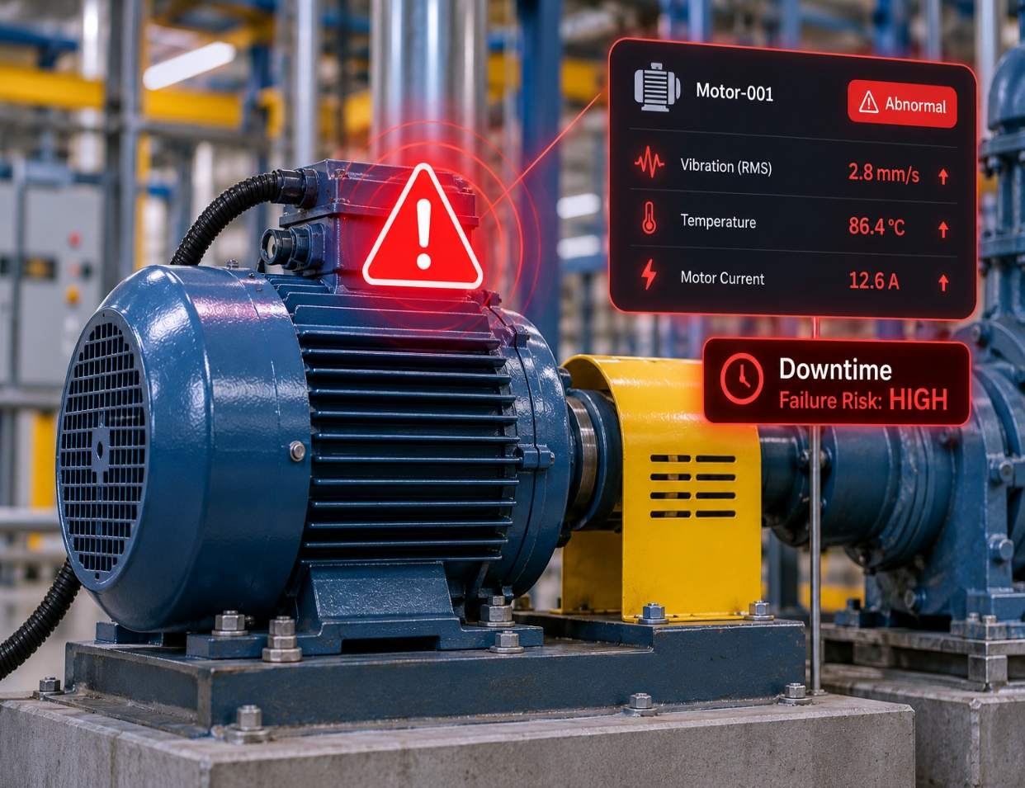
Problem Statement
Unplanned equipment downtime causes production losses, safety risks, and high repair costs. Traditional maintenance is reactive or calendar-based, rather than based on real machine condition.
Problems
Failures are often detected after damage has occurred.
Fixed-interval maintenance may replace healthy parts too early.
Maintenance teams lack real-time asset-health visibility.
Alerts do not automatically become SAP work orders.
Spare-part availability is checked manually.
IoT/AI systems and SAP ERP workflows remain disconnected.
Notes:
Total duration: 5mins
Learning Objective: In this slide, the trainer will explain the students what they will learn and be able to apply in the real life situations.
Procedure: Discuss the above as the outcome of the session
Learning outcome: Students will understand the learning outcome in this slide.

Slide 4
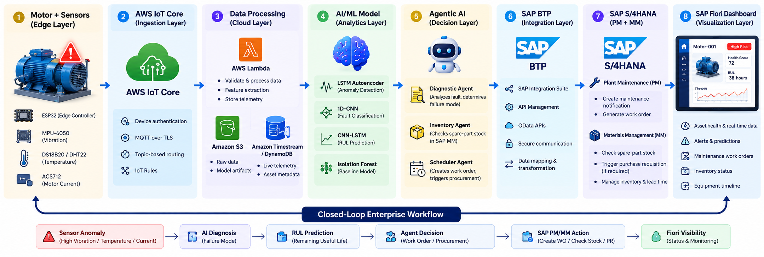
Project overview - Introduction
The project creates a closed-loop predictive-maintenance system that connects physical equipment, cloud AI, and SAP S/4HANA.
Pico W/ESP32 collects vibration, temperature, and current data.
Data is sent to AWS IoT Core through MQTT.
AWS Lambda processes data and extracts FFT-based features.
Deep-learning models detect anomalies and estimate RUL.
Agentic AI decides the required maintenance action.
SAP PM creates work orders; SAP MM verifies spare parts.
SAP Fiori displays asset health and maintenance status.
Notes:
Total duration: 5mins
Learning Objective: In this slide, the trainer will explain the students what they will learn and be able to apply in the real life situations.
Procedure: Discuss the above as the outcome of the session
Learning outcome: Students will understand the learning outcome in this slide.

Slide 5
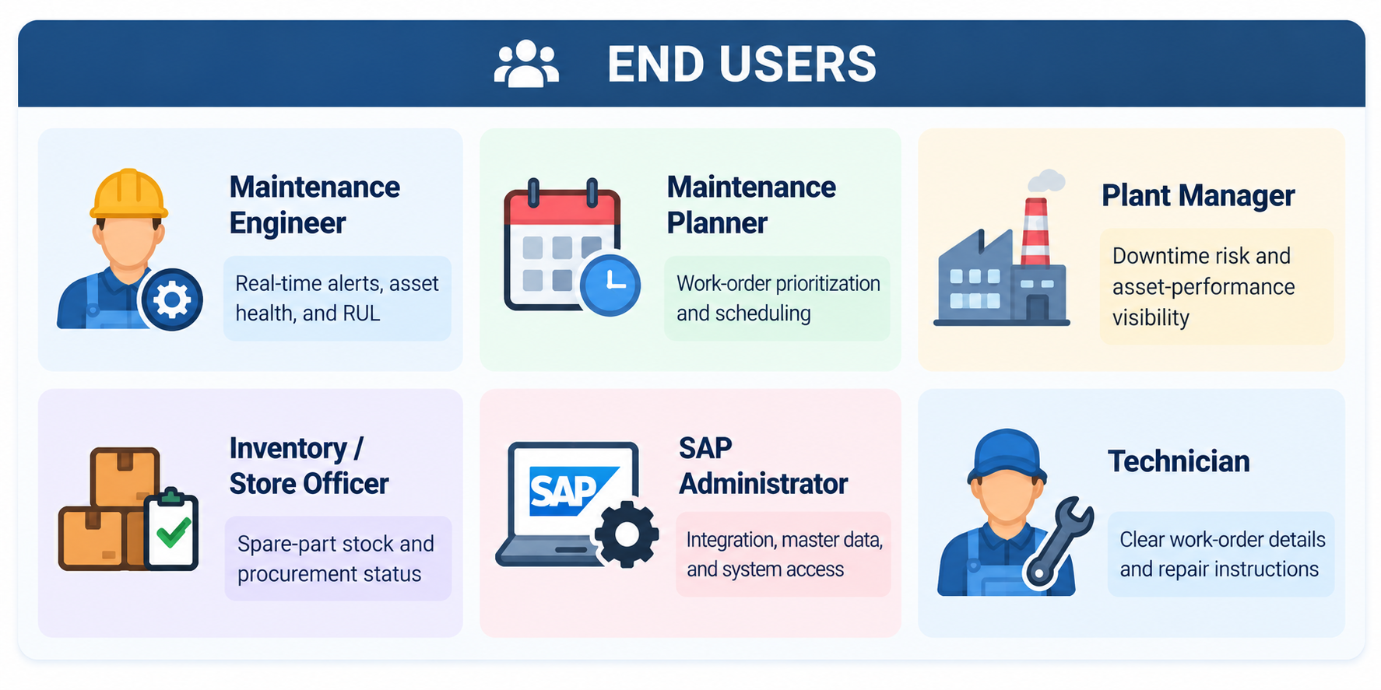
End User
Primary users are maintenance engineers, planners, and plant managers who need early failure warnings and automated SAP maintenance workflows.
Notes:
Total duration: 5mins
Learning Objective: In this slide, the trainer will explain the students what they will learn and be able to apply in the real life situations.
Procedure: Discuss the above as the outcome of the session
Learning outcome: Students will understand the learning outcome in this slide.

Slide 6
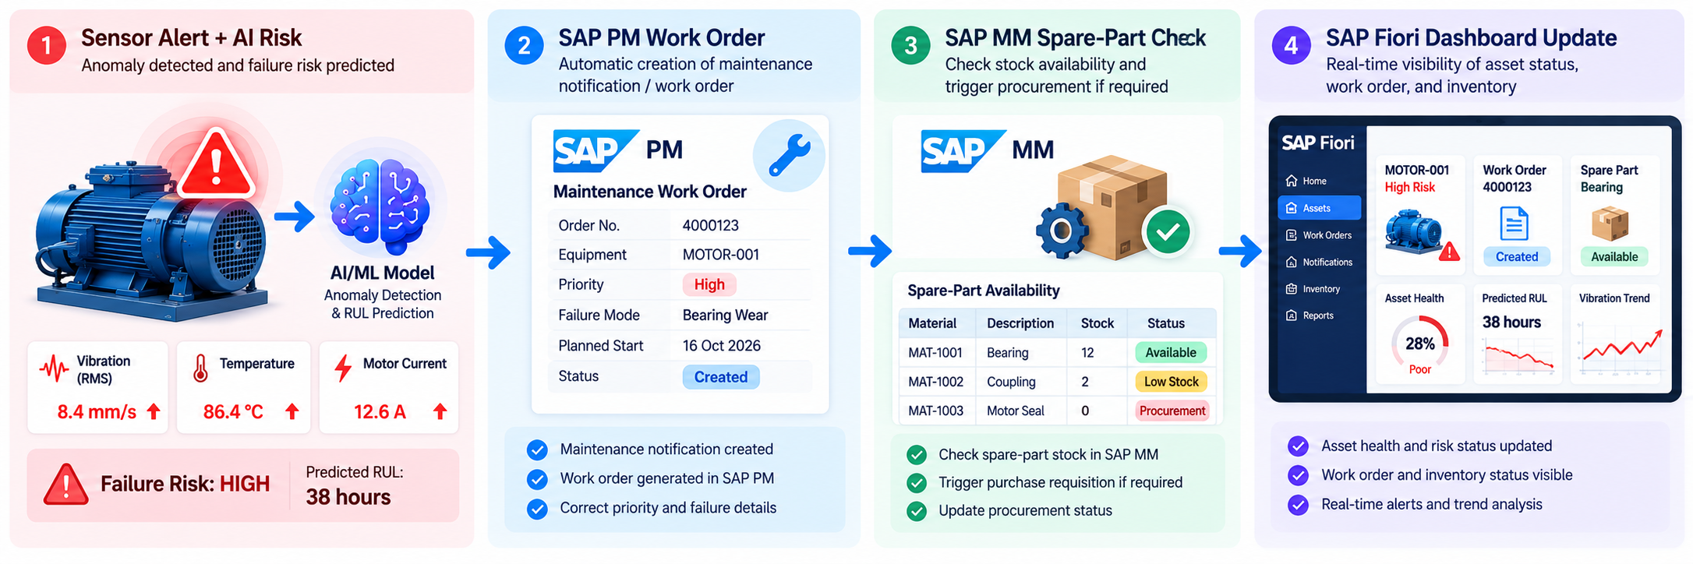
Wow factor
Not just a prediction dashboard – “an autonomous SAP-driven maintenance engine”.
Closed-loop ERP action: AI alerts automatically create SAP PM work orders.
Multi-sensor digital twin for live asset-health monitoring.
FFT-based vibration analysis for early fault detection.
LSTM Autoencoder for anomaly detection.
CNN-LSTM model for RUL prediction.
Agentic AI for diagnosis, inventory checking, and scheduling.
SAP MM automatically checks spare parts and raises requisitions.
Notes:
Total duration: 5mins
Learning Objective: In this slide, the trainer will explain the students what they will learn and be able to apply in the real life situations.
Procedure: Discuss the above as the outcome of the session
Learning outcome: Students will understand the learning outcome in this slide.

Slide 7
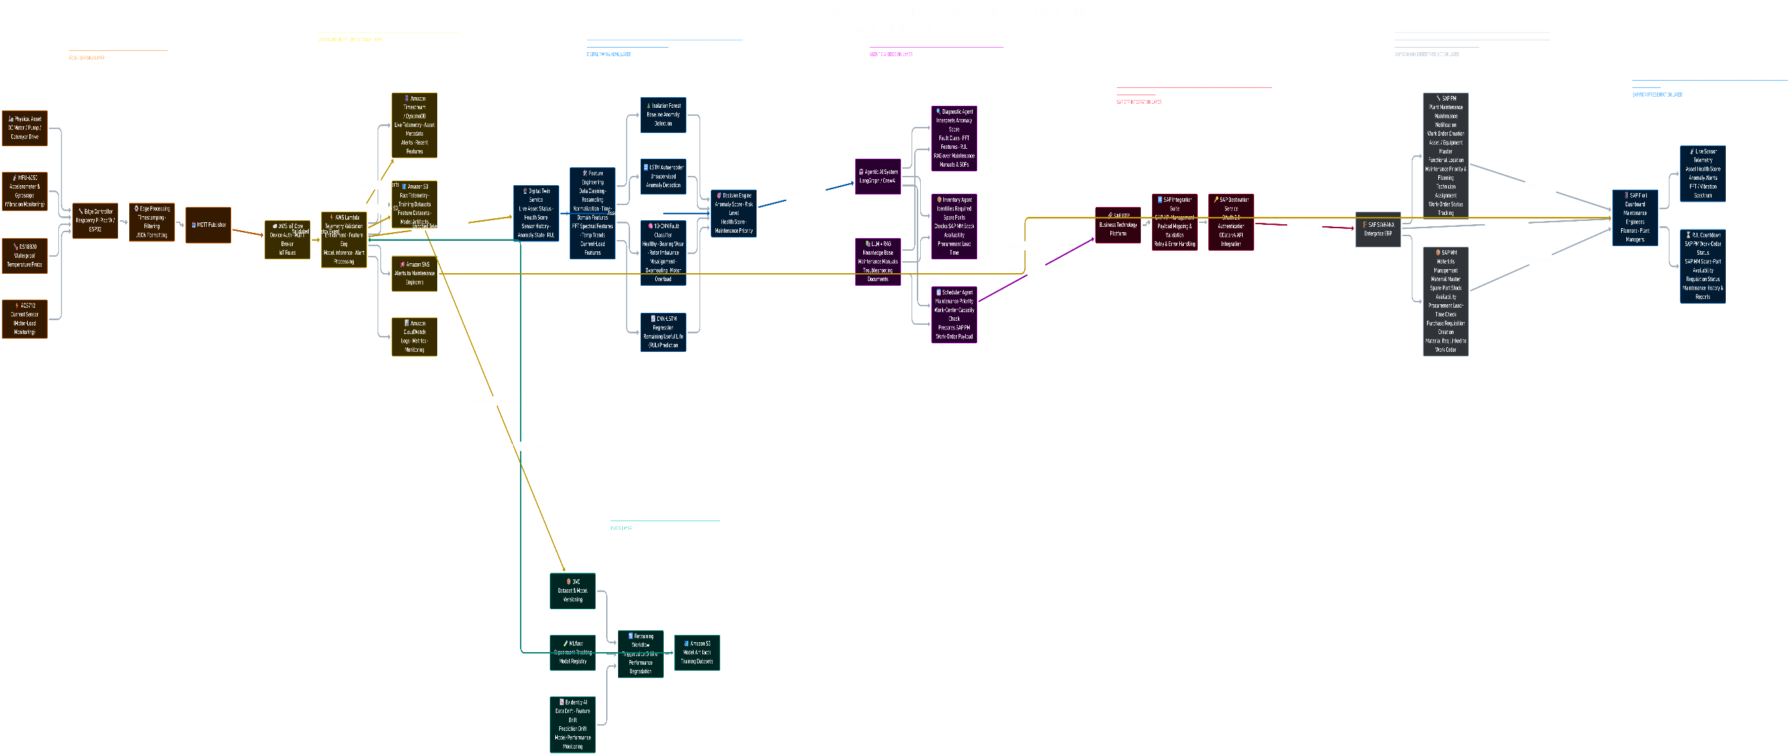
Modelling
Edge layer:
Pico W/ESP32, MPU-6050, DS18B20, ACS712, MQTT.
Cloud layer:
AWS IoT Core, Lambda, S3, Timestream/DynamoDB.
AI layer:
FFT features, LSTM Autoencoder, 1D-CNN, CNN-LSTM RUL.
MLOps layer:
DVC, MLflow, Evidently AI.
Agentic layer:
Diagnostic, Inventory, and Scheduler agents.
SAP layer:
SAP BTP, OData, S/4HANA PM, MM, Fiori.
Notes:
Total duration: 5mins
Learning Objective: In this slide, the trainer will explain the students what they will learn and be able to apply in the real life situations.
Procedure: Discuss the above as the outcome of the session
Learning outcome: Students will understand the learning outcome in this slide.

Slide 8
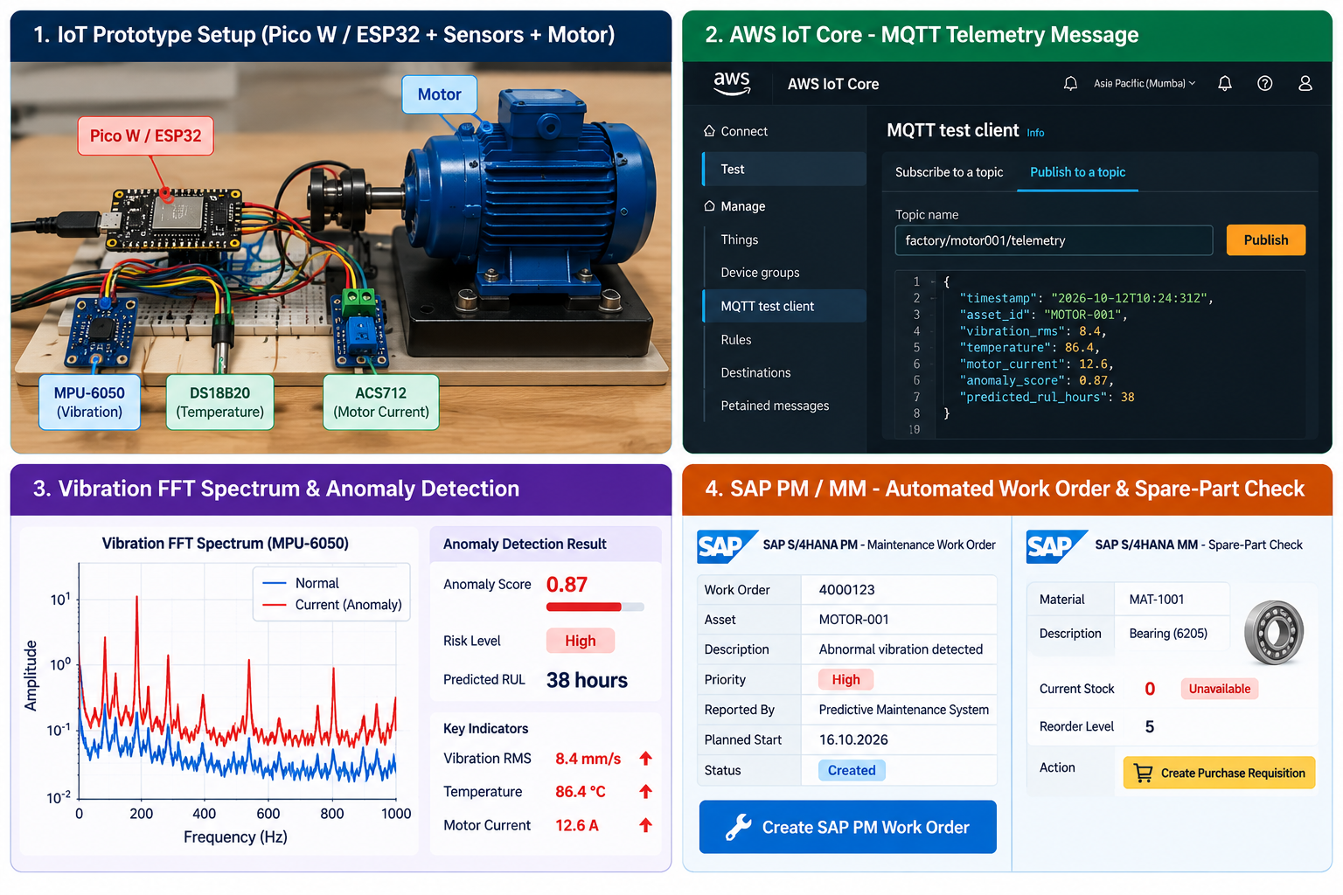
Result / Outcomes
Early fault detection → SAP PM work order → spare-part readiness → reduced unplanned downtime.
Notes:
Total duration: 5mins
Learning Objective: In this slide, the trainer will explain the students what they will learn and be able to apply in the real life situations.
Procedure: Discuss the above as the outcome of the session
Learning outcome: Students will understand the learning outcome in this slide.

Slide 9

Conclusion
This project demonstrates a complete Industry 4.0 predictive-maintenance solution that connects physical equipment, cloud AI, agentic intelligence, and SAP S/4HANA. It converts sensor anomalies into automated SAP PM work orders and SAP MM spare-part actions.
Notes:
Slide duration: 5 min
Objective: To get clarity about the lesson is well received among students.
Procedure:
Ask: What did you learn from the lesson?
What is your takeaways from the lesson?
How this lesson is going to help you in your personal and professional life.
How are you going to implement this lesson?

Slide 10
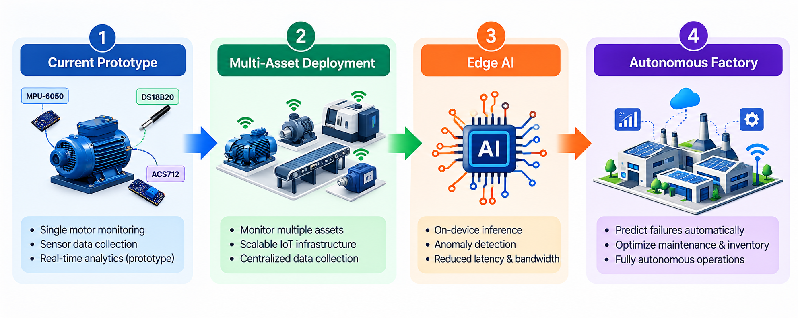
Future Perspective
Future Scope
Extend to multiple assets and plants.
Add edge AI using TensorFlow Lite Micro.
Integrate PLC, SCADA, and OPC-UA systems.
Add computer vision for visual inspection.
Use generative AI for maintenance-report generation.
Implement predictive spare-part demand forecasting.
Build a mobile SAP Fiori app for technicians.
Notes:
Total duration: 5mins
Learning Objective: In this slide, the trainer will explain the students what they will learn and be able to apply in the real life situations.
Procedure: Discuss the above as the outcome of the session
Learning outcome: Students will understand the learning outcome in this slide.

Slide 11

Thank You
Notes:
Time: 25 to 30 Sec

